Slide 1




Slide 2

What is UzQR?
UzQR is a platform developed as part of a project by the Central Bank of the Republic of Uzbekistan to implement a unified standard for accepting QR code payments.
The goal of the project is to make QR payments simple, convenient, and accessible for all market participants, allowing customers to pay for goods and services through any banking or payment application, while enabling businesses to accept such payments using a single QR code.
UzQR brings banks and payment service providers together into a unified QR payment ecosystem, ensuring a standardized and seamless payment experience.

Slide 3

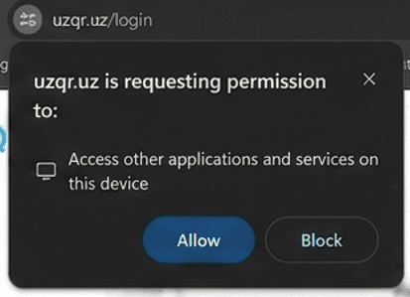
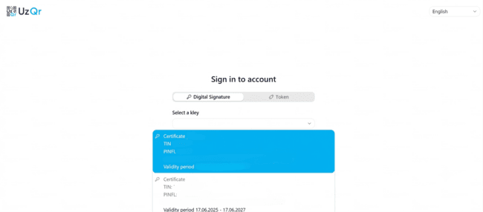
Login to the Personal Account
When you first open the page, your browser may request permission for the website to interact with the E-IMZO application installed on your computer.
Click "Allow".
Authorization
To log in:
Select the E-IMZO authentication method
Choose your electronic signature certificate
Enter your EDS password
Click "OK"
After successful verification, the Personal Account will open.

Slide 4
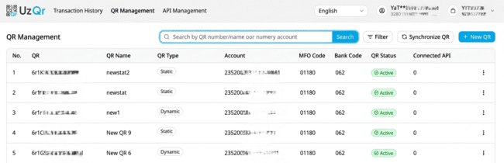
QR Code Creation
QR Code Creation
To start accepting payments, you need to create a QR code.
Open "QR Management" and click "New QR".

Slide 5
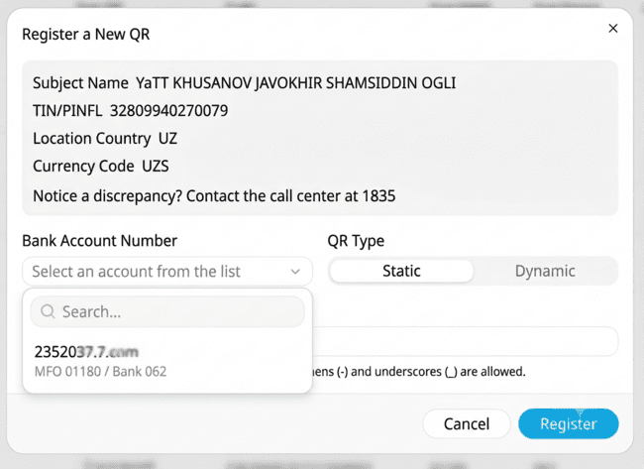
How to Create a QR Code
How to Create a QR Code
Select a bank account
Choose the QR code type
Enter the QR code name
Click "Register"
After successful registration, the QR code will appear in the list.

Slide 6
Bank Account Selection
Select the account to which funds received through this QR code will be credited.
Only accounts available for registration are displayed in the list.
Important:
Multiple QR codes can be registered for a single bank account.
Selecting a QR Code Type
When registering a QR code, you must select its type.
Static QR
Used for printing and displaying at a point of sale.
Dynamic QR
Used to automate payment acceptance through point-of-sale (POS) software.
QR Code Name
Use clear and descriptive names so you can easily find the required QR code later.
For example:
SHOP
CASH_1
DELIVERY
After completing the form, click "Register".

Slide 7
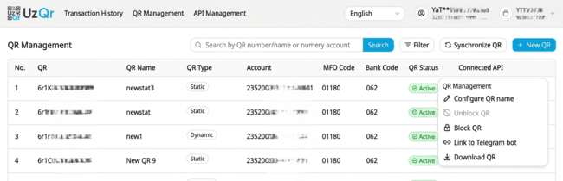
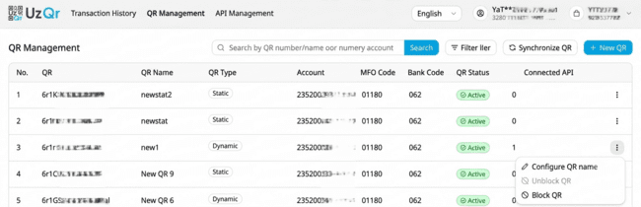
QR Code Management
QR Code Management
After registering a QR code, you can edit its settings, temporarily suspend payment acceptance, or download the QR code for printing.
To perform an action, click the ⋮ button next to the desired QR code.
The available actions depend on the QR code type.
Static QR
Edit QR code name
Block QR code
Unblock QR code
Link to a Telegram bot
Download QR code
Dynamic QR
Edit QR code name
Block QR code
Unblock QR code

Slide 8
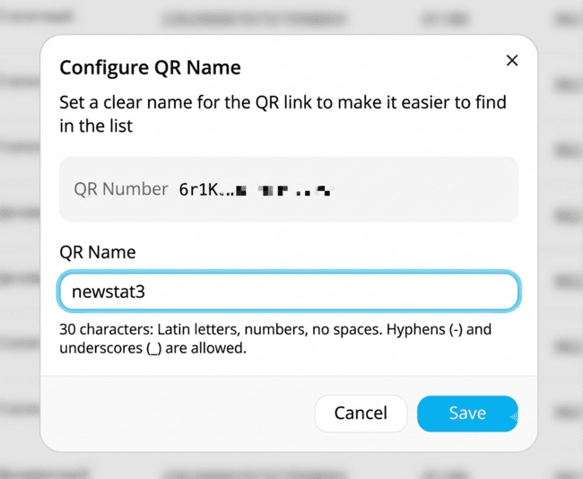
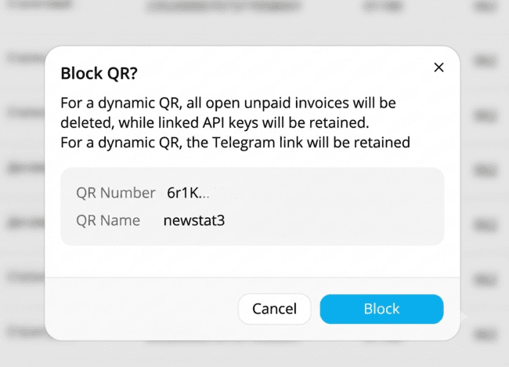
Editing a QR Code Name and Blocking a QR Code
Editing a QR Code Name and Blocking a QR Code
Use this feature if you need to change the QR code name.
How to Change a QR Code Name
Click ⋮ next to the desired QR code
Select "Edit QR Code Name"
Enter a new name
Click "Save"
The new name will be displayed in the QR code list immediately after saving.
QR Code Blocking
Use the blocking feature if you need to temporarily stop accepting payments.
How to Block a QR Code
Click ⋮ next to the desired QR code
Select "Block QR Code"
Confirm the action
Important
After a QR code is blocked, new payments can no longer be accepted.
For dynamic QR codes, additionally:
New payment QR codes will no longer be generated
Unpaid QR codes will be automatically deleted
API keys will be retained

Slide 9
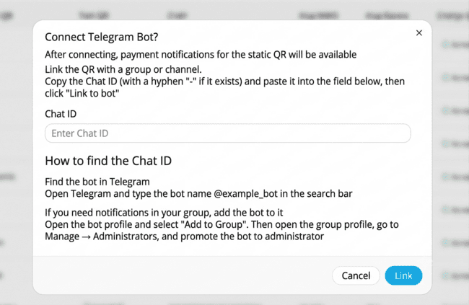
Connecting a Telegram Bot
Connecting a Telegram Bot
The Telegram bot allows you to receive notifications about successful payments made through a static QR code.
How to Connect Telegram
Click ⋮ next to the static QR code
Select "Link to Telegram Bot"
Enter the Chat ID
Click "Link"
After successful connection, notifications will be sent automatically to the selected chat.
Important
The Telegram bot feature is available only for static QR codes.

Slide 10
Downloading a QR Code
A static QR code can be downloaded and used to accept payments.
How to Download a QR Code
Click ⋮ next to the static QR code
Select "Download QR Code«
The downloaded QR code can be:
Printed
Displayed at the checkout counter
Placed in a shop window
Used in promotional materials
QR Code Synchronization
If a registered static QR code is not displayed in the Personal Account, use the synchronization feature.
How to Synchronize QR Codes
Open "QR Management«
Click "Synchronize QR Codes"
Once synchronization is complete, any missing static QR codes will automatically appear in the list.
Important
Synchronization is available only for static QR codes.

Slide 11
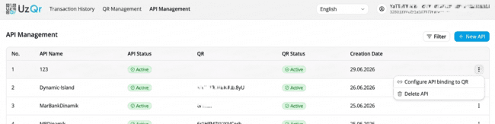
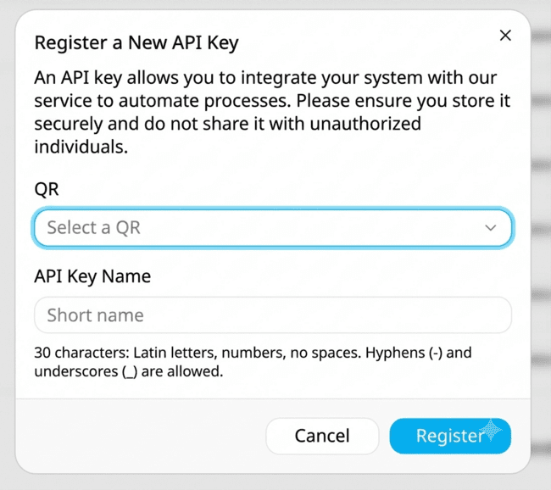
Creating and Managing API Keys
An API key is used to connect point-of-sale (POS) software to UzQR.
API keys can be created only for dynamic QR codes.
Creating an API Key
How to Create an API Key
Click "New API«
Select a dynamic QR code
Enter the API name
Click "Create"
Important
An API key can only be created for a dynamic QR code registered in UzQR.

Slide 12
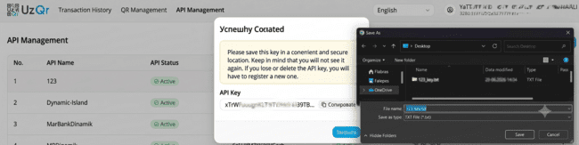
Obtaining an API Key
After an API is created, the system automatically generates an API key.
Available Actions
Copy the API key
Save the API key to a file
Close the window
Important
The API key is displayed only once. After the window is closed, it cannot be retrieved again.
It is recommended to save the API key immediately after it is generated.

Slide 13
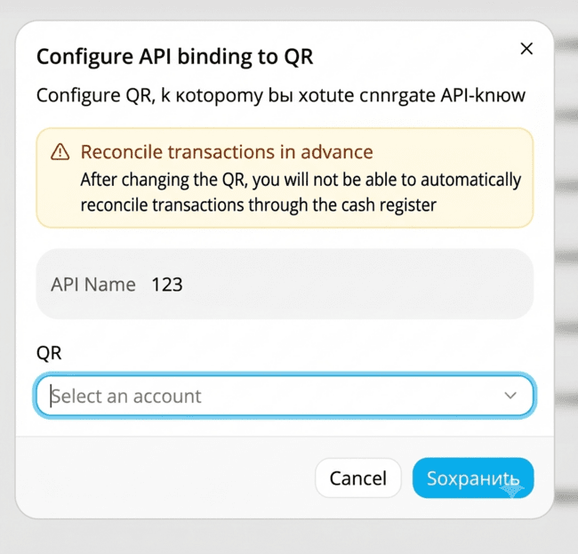
Changing API Assignment
Changing API Assignment
If you need to use an API with a different dynamic QR code, you can change its assignment.
How to Change API Assignment
Click ⋮ next to the desired API
Select "Configure API-to-QR Assignment“
Select a new QR code
Click "Save"
Recommendation
Before changing the assignment, it is recommended to reconcile transactions associated with the current QR code.
After saving the changes, the API key will be used with the new QR code.

Slide 14

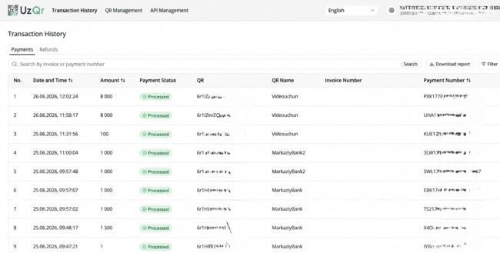
Transaction History
In the "Transaction History" section, you can:
- View payments
- Process refunds
- Track refund statuses
- Export transaction history
The history consists of two tabs:
- Payments
- Refunds

Slide 15
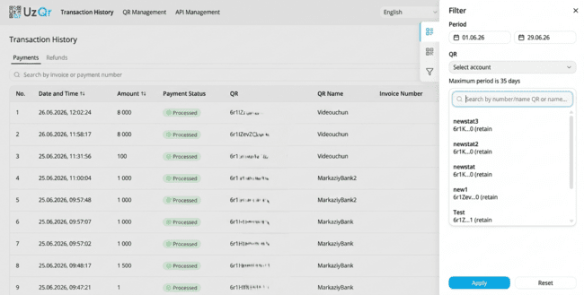
Viewing Payments
The "Payments" tab displays all completed payments.
Use the search bar to quickly find a transaction.
Search is available by:
Payment number
Invoice number
Filtering Payments
To find transactions for a specific period:
Click "Filter“
Select the desired period
If necessary, select a QR code
Click "Apply"
Important
The maximum search period is 35 days.

Slide 16
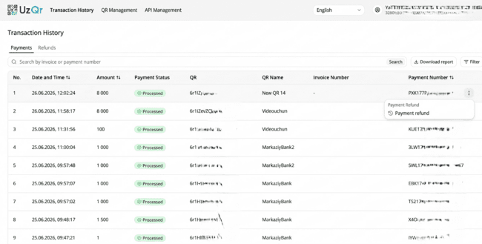
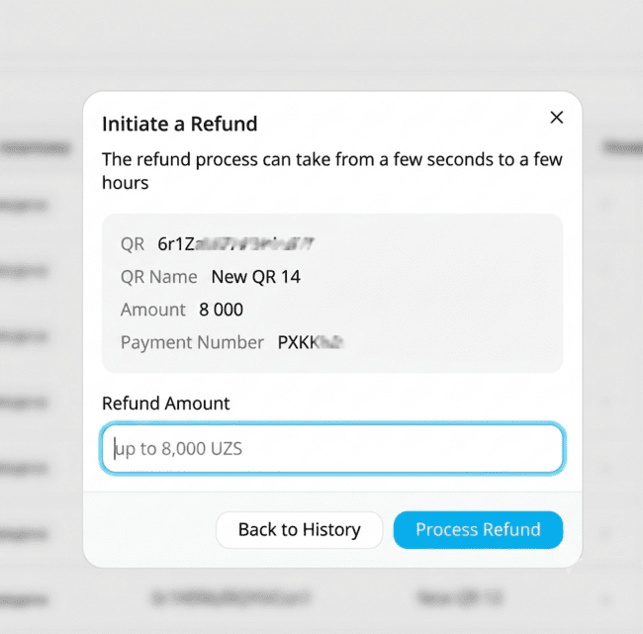
Payment Refund
If you need to return funds to a customer, you can process a refund directly from the list of payments.
How to Process a Refund
Find the required payment
Click ⋮
Select "Refund Payment"
Important
The refund amount cannot exceed the amount of the original payment.
Note
Refund processing may take from a few seconds to several hours.
Once a refund is created, it will automatically appear in the "Refunds" tab.
In the window that opens:
Verify the payment information
Enter the refund amount
Click "Process Refund"

Slide 17
Viewing Refunds
The "Refunds" tab displays all processed refunds.
Use the search and filter functions the same way as for payments.
Filtering Refunds
To find refunds:
Click "Filter"
Select the refund date
If necessary, select a QR code
Click "Apply"
Exporting Refunds
To save the refund history:
Click "Download Report"
The report will be generated in CSV format.

Slide 18
Recommendations
Recommendations, The following recommendations will help make working with the system more convenient as the number of QR codes, cash registers, and integrations grows.
Use a Separate QR Code for Each Cash Register
Multiple QR codes can be registered to a single bank account.
If you use multiple cash registers, it is recommended to create a separate QR code for each one.
This will allow you to:
Quickly identify the source of a payment
Simplify transaction searches
Reconcile transactions more efficiently
Use a Separate API Key for Each Cash Register
It is recommended to assign a dedicated API key to each cash register.
Each API key should be linked to its own dynamic QR code.
This will allow you to:
Replace or disable one cash register without affecting the others
Identify the source of issues more quickly
Simplify maintenance of cash register equipment
Save the API Key Immediately After Creation
Once the API key window is closed, the API key cannot be retrieved again.

Slide 19
It is recommended to:
Save the API key to a file
Share it with the responsible employee
Store it in a secure location
Example of Workflow Organization
Below is one of the possible ways to organize your workflow.
Settlement Account
├── Static QR
│ └── Telegram
│
├── Dynamic QR “Cash 1"
│ └── API POS_1
│
├── Dynamic QR “Cash 2"
│ └── API POS_2
│
└── Dynamic QR “Cash 3"
└── API POS_3
This structure allows you to use a single bank account while still easily identifying which cash register was used to process each payment.

