Slide 1
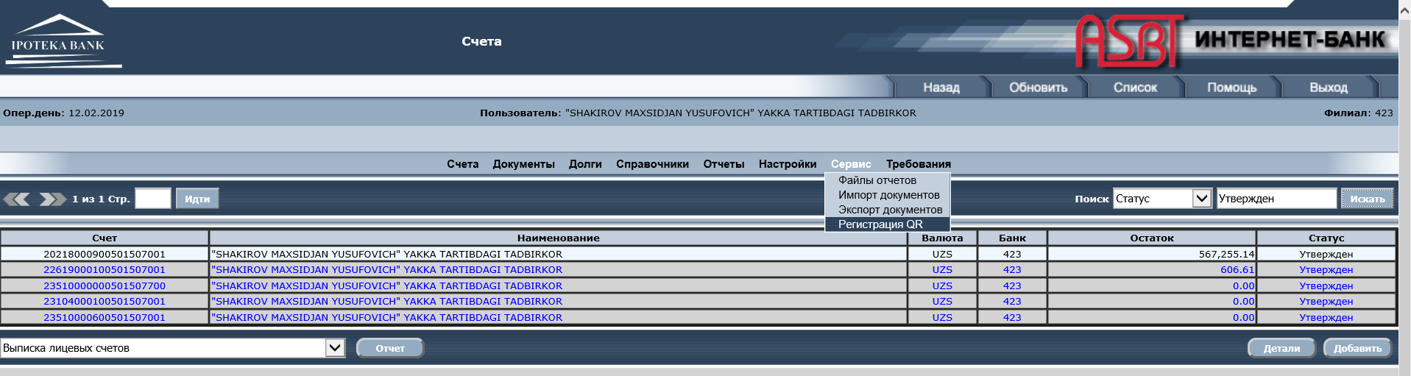
Instructions for JSCIB "Ipoteka-Bank" Clients on UzQR Registration
To register a QR code, the client of JSCIB "Ipoteka-Bank" logs into the Internet Banking system using their username and EDS (Electronic Digital Signature). Upon logging in, a table of functions appears. One of the functions is “РегистрацияQR” (QR Registration), which can be accessed by clicking the “Сервис” (Service) button.

Slide 2
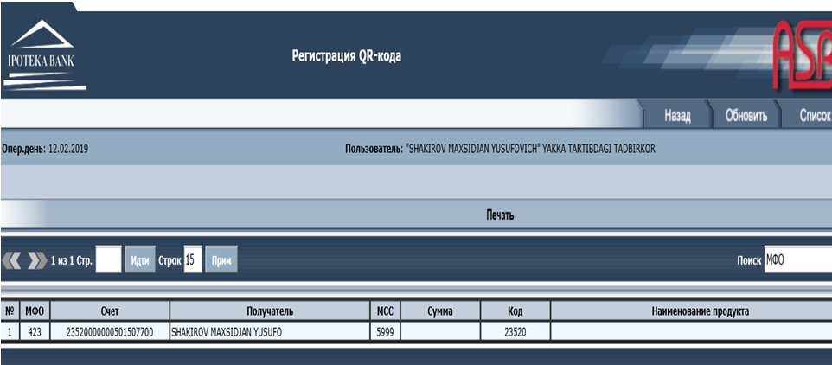
QR Code Table
When selecting the “Регистрация QR” function, a table with QR codes opens. The “Детали” (Details) button allows viewing data for previously registered QR codes. The “Добавить” (Add) button opens a table with blank cells to fill in the data required to open a new QR code.

Slide 3
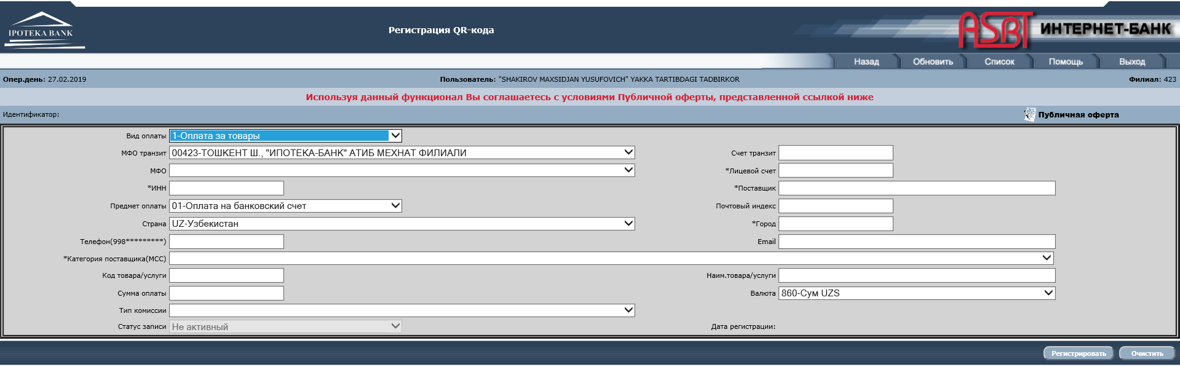
New QR Code Registration
In the registration table for a new QR code, which opens after clicking the “Добавить” button, there are drop-down selection cells and fillable cells (cells marked with an asterisk * are mandatory). In the “Телефон” (Phone) cell, specify the phone number where notifications about successful incoming payments from plastic cards will be sent. In the “Код товара/услуги” (Product/Service Code) cell, the transit account 23520 (a special account designed for UzQR) must be entered. “Лицевой счёт” (Current/Settlement Account) is the account where revenues will be transferred from account 23520. Also, prior to registering a new QR code, you must review the Public Offer (“Публичная оферта”), which opens and is saved within this QR code for further viewing.

Slide 4
New QR Code Registration
If the client is registering a QR code for the first time, the “Счёт транзит” (Transit Account) cell must be filled out in the following format: 23520000_НИББД001. If it is the second time: 23520000_НИББД002, and so on. Upon clicking the “Регистрировать” (Register) button, a message showing the correct 23520 transit account will appear. You need to copy it, paste it into the “Счёт транзит” cell, and then click the “Регистрировать” button again.
Note: The 23520 transit account is opened through the NIBBD (National Information Database of Bank Depositors), so the QR code registration process may take some time.

Slide 5
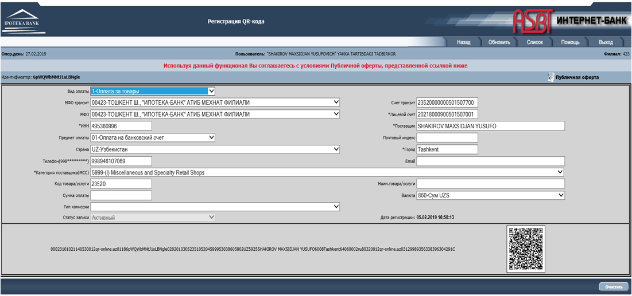
QR Code Assignment
After filling out the New QR Code Registration table and receiving a success message upon clicking the “Регистрировать” button, an image will appear in the bottom right corner of the table—this is the QR code assigned to this client.
Next Steps: 1. You need to download the QR code image.

Slide 6
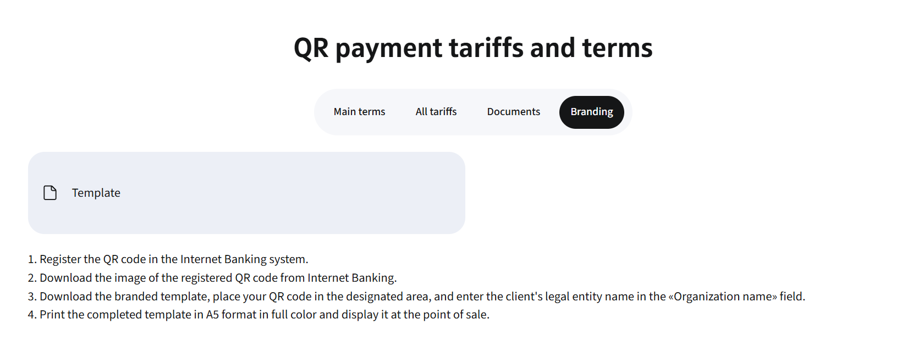
2. Go to the official Ipoteka Bank website and download the file named “Шаблон” (Template). This template is approved by the Central Bank.

Slide 7
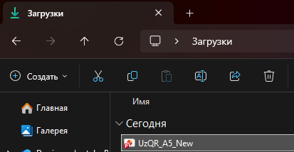
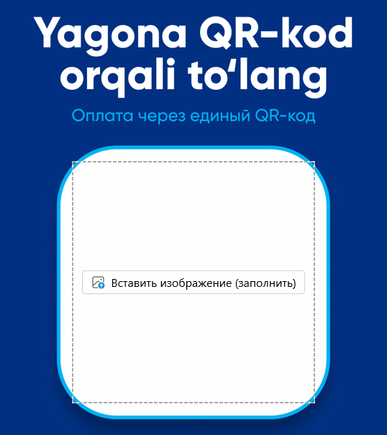

3. Open the downloaded file.
4. In the center of the template, there is a specially designated space for the QR code previously downloaded from the internet banking platform. Click the “Вставить изображение” (Insert Image) button and upload your QR code.
5. Below the QR code, there is a designated field for the organization's name, which must be filled out (Example: OOO Super Market).
6. Save the completed file and print it using a color printer.

Slide 8
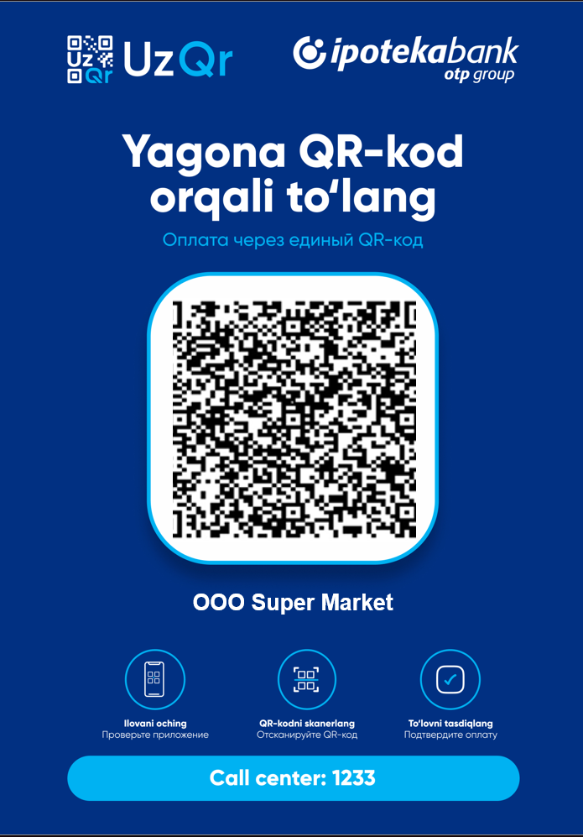
Expected result / How the final result should look:

